Slide 1


Embedded Software Process
Author. NghiaNV16
Aug 31 2023

Slide 2
1
1
Embedded software overview
CONTENT
2
Embedded software development
3
Embedded software process
© Copyright FPT Software – Level of Confidentiality

Slide 3
01. Embedded software overview

Slide 4

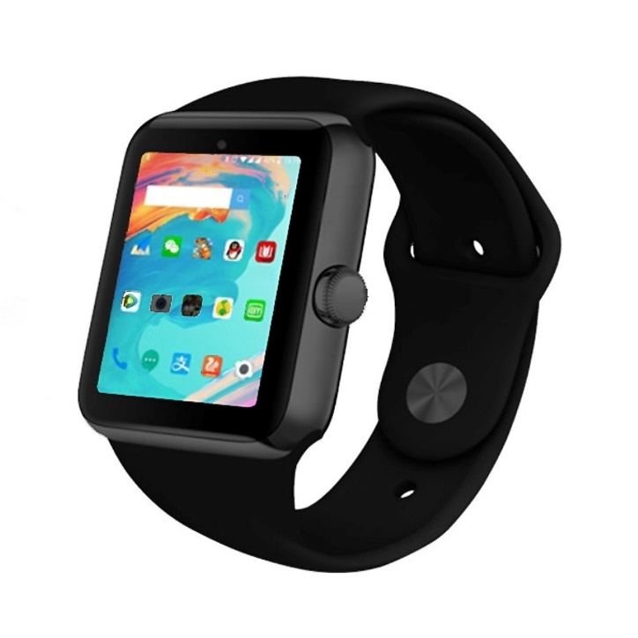
Embedded Software Overview
Embedded software is computer software, written to control machines or devices that are not typically thought of as computers.
It is typically specialized for the particular hardware that it runs on and has time and memory constraints.
This term is sometimes used interchangeably with firmware

Slide 5
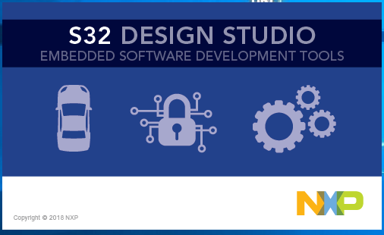
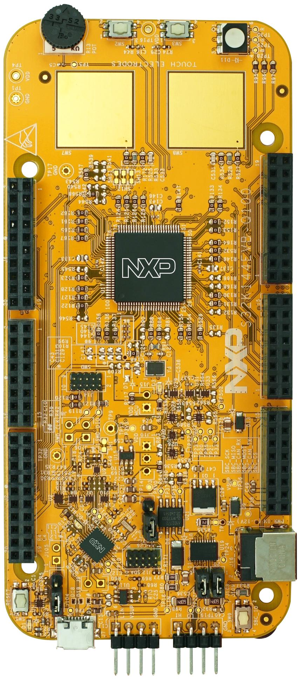
What is needed to start?
Development board
Debug Adapter
IDE and Software packet
Documents
S32K144 Datasheet
S32K144EVB Schematic
Cortex M4 Device
Generic User Guide
S32K144 Reference Manual
S32K144EVB User Guide

Slide 6
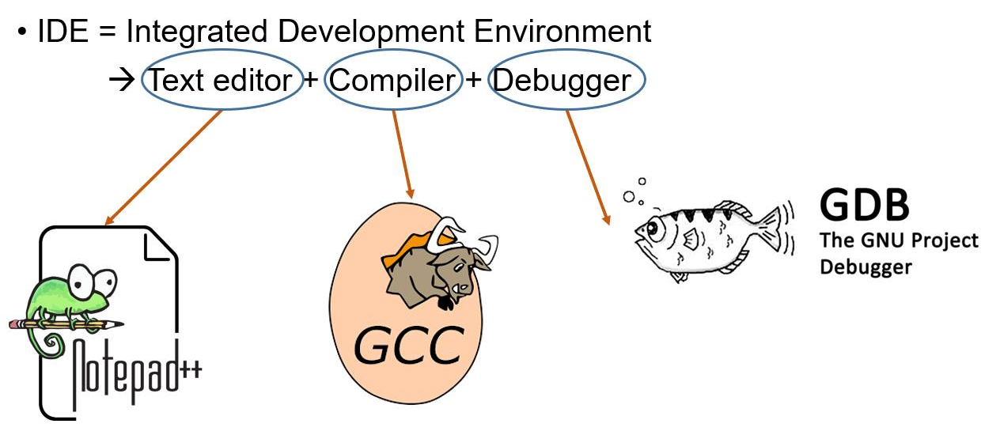
What is needed to start?

Slide 7
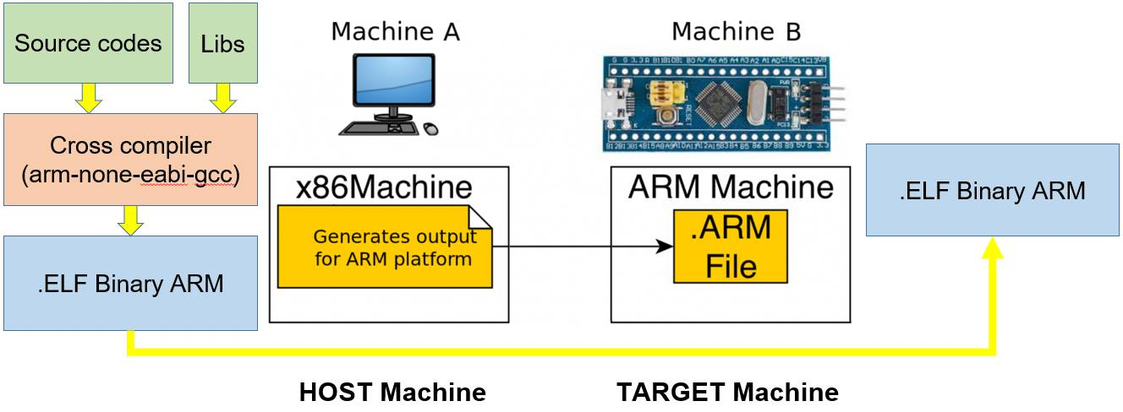
Embedded Software Features
Acts directly with and on the hardware
Quite limited resources

Slide 8
02. Embedded software development

Slide 9
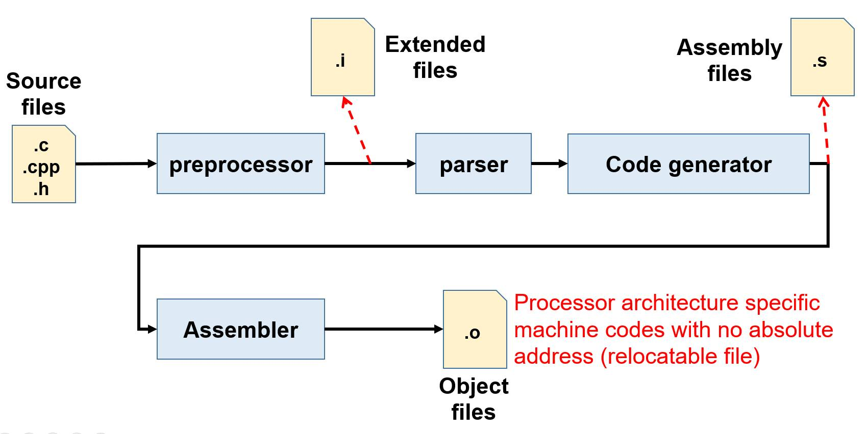
Embedded Software Build Process

Slide 10
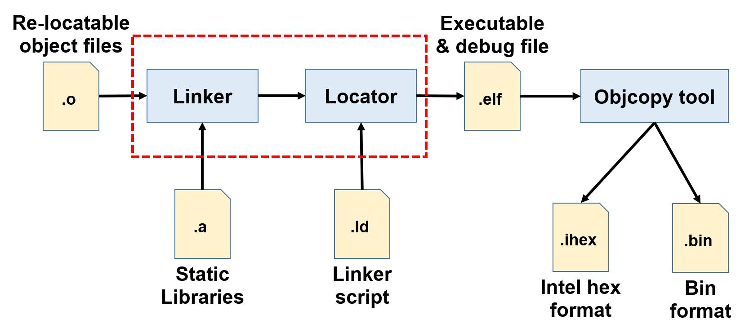
Embedded Software Build Process

Slide 11
Reset Sequence
Text Code | …. | ….
 | 0x1000 | void main() { main code }
 | 0x500 | void Reset_handler(void) { Startup Code main() }
 | …. | ….
PC = 0x500
Vector Table | …. | ….
 | 0x0000.0004 | &Reset_Handler() – ex. 0x500
 | 0x0000.0000 | Reset Value of Stack Pointer
Processor will
start here

Slide 12
Embedded Software Components
Stack
Startup File
  Vector Table
  Startup Code/Reset_Handler()
Linker Script File
Application Code
  Main Code
  Library Code
Heap
RAM
Un-Initialized data
Initialized data
Initialized data
main() and application code
Startup Code
Setup Stack Pointer
Init .bss section
Copy data Flash to RAM
Call main() function
FLASH
Vector Table

Slide 13
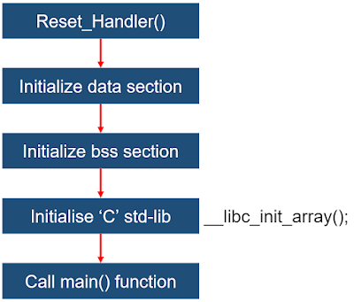
Startup Code

Slide 14
03. Embedded software process

Slide 15

Problem?
Design a Micro-Controller Project for DataLogger
  Read Sensor by ADC Peripheral (Ex. Temperature)
  Calculate Data – Convert to Physical Value – Temperature
  Display Data to LCD
  Save 10 lastest values

Slide 16
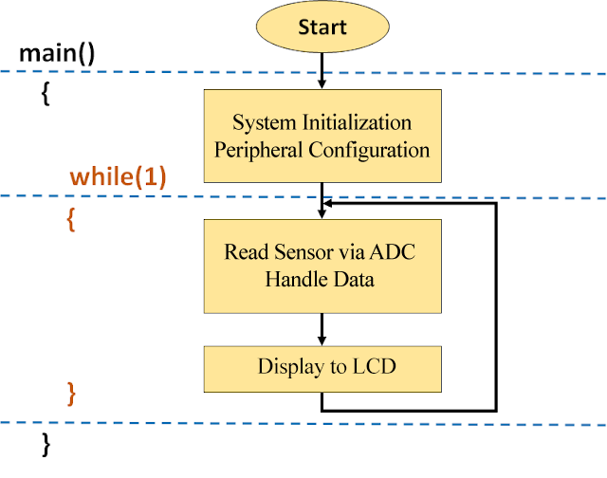
Solution 1 - Polling
Advantage
  Simple to implement
Dis-Advantage
  Low performance
  Waste energy
  Can't do other things

Slide 17
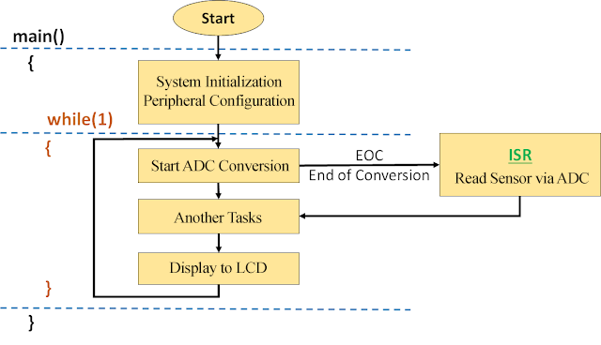
Solution 2 - Interrupt
Advantage
  Can do other things
  Save energy
  Prioritize important events
Dis-Advantage
  More complex
  Difficulty in debugging

Slide 18
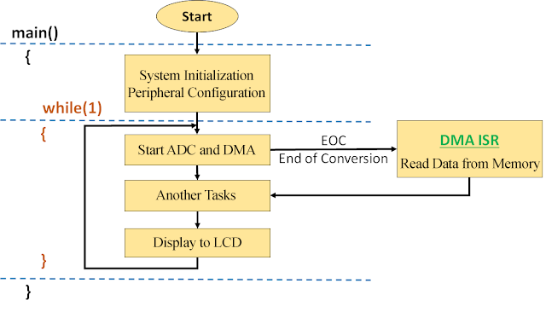
Solution 3 – DMA – Direct Memory Access
Advantage
  Can do other things
  Save energy
  Save CPU time
Dis-Advantage
  More complex

Slide 19

CONTACT US
FPT Cau Giay Building, Duy Tan Street, Dich Vong Hau Ward, Cau Giay District, Hanoi City, Vietnam
Contact Person: Nghia Nguyen Van
Email: NghiaNV16@fpt.com

